Slide 1
AVIATION RISK ANALYSIS
Using proven historical data to analize the best potential aircraft acquisition
By: BRIAN AYIMBA

Slide 2
Overview
Purpose of This Analysis
This analysis identifies lower-risk aircraft options using historical accident data
Outcome
Clear, actionable recommendations for aircraft acquisition

Slide 3
Business Aspect
Key Business Question
Which aircraft types present the lowest operational risk for commercial and private use?
Why This Matters
● Safety incidents increase:
○ Insurance premiums
○ Legal liability
○ Reputational damage
● Early aircraft choices determine long-term risk exposure

Slide 4
Data Aspect
Data Source
● National Transportation Safety Board (NTSB)
● Aviation accident data (1962–2023)
What We Focused On
● Accident frequency
● Injury severity as a proxy for operational risk

Slide 5
Risk parameters used
Severity Scoring Approach
● Fatal injuries → High risk
● Serious injuries → Moderate risk
● Minor or no injuries → Lower risk

Slide 6
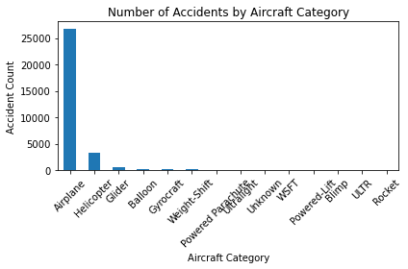
Accident Frequency by Aircraft Category
Insights:
Fixed-wing aircrafts have the highest accident count due to the volume of use.
Using severity to analyize makes it more feasible as compared to the accident count

Slide 7
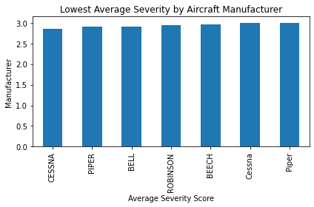
Average Accident Severity by Aircraft Category
Insights
Fixed-wing commercial aircraft show
lower severity outcomes
Helicopters and experimental aircraft
show higher average severity

Slide 8
Business recommendations;
Prioritize fixed-wing commercial aircraft
They demonstrate the lowest combined frequency and severity risk
Avoid experimental aircraft and rotorcraft in early expansion
They show higher severity outcomes and operational volatility

Slide 9
THANK YOU

